Slide 1

Learn C++ Programming
Abhijit Roy
Notes:
ID=d924773e-9a16-4d6d-9803-8cb819e99682 Recipe=text_billboard Type=TextOnly Variant=0 FamilyID=AccentBoxWalbaum_Zero

Slide 2

Instructor
Industry:
Data Science
Blockchain
Bots
Android
“I am a Software Developer, holding past experiences in Applications Development, Data Science, Bots, Blockchain, ML, DL. I am proficient in multiple programming languages, mainly – C++, Python. My journey started from Android, then to Blockchain & then to Data Science. I am currently involved into teaching & different interest-based projects involving C++, Python. I am committed to make the society free from problems by making every business with inherent features - Transparency, Incentivization and Decision-making rights.”
Language Proficiency:
Back-end: C++, Python, Java
Front-end: XML, HTML, CSS

Slide 3

About
extension of the C programming language
created in 1986
Stable release version: C++20

Slide 4





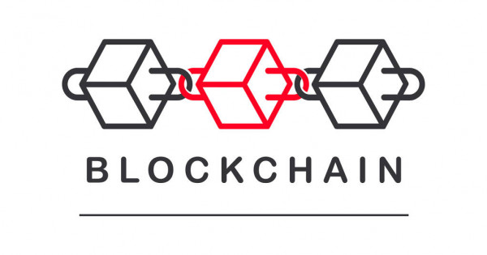
Application
Application Development – Web + Mobile
Data Science
Machine Learning, Deep Learning
Blockchain, Smart Contract Development
Computing Engine
Game Development

Slide 5
Programming Types
OOP, Functional, Generic, Procedural, Modular

Slide 6

OOP
Create an object – car
Attributes
Model, e.g. BMW 320d
Make, e.g. 2017
Brake – applied or not
Door – open or close

Slide 7

Happy Coding! ☺
Follow Block.Hub Academy on:
Udemy
Medium
Twitter
Github
Facebook
YouTube
Telegram

Slide 8

THANKS

